Slide 1



NAMI’s Contribution to the S&T Industry and Environmental Protection
Ka Ming NG (吳嘉名)
CEO
Nano and Advanced Materials Institute, Ltd.
Chair Professor
Chemical and Biomolecular Engineering Department
The Hong Kong University of Science and Technology
Clear Water Bay, Hong Kong
Acknowledgments: Prepared by Sarina LAU and Ka Wai WONG
Presentation at Networking Dinner “Use of Innovation and Technology in Environmental Protection and Testing” January 19, 2011

Slide 2
The Strategy – HK as a Technology Market Place
Branding
High tech manufacturing
Finance
Innovation policies
Government
Industry
Capital Market
Promotion of economic development
$
$
$
R&D Institutes
Process development
University
Human capital
Product development
Fundamentals
Pilot testing and prototyping

Slide 3
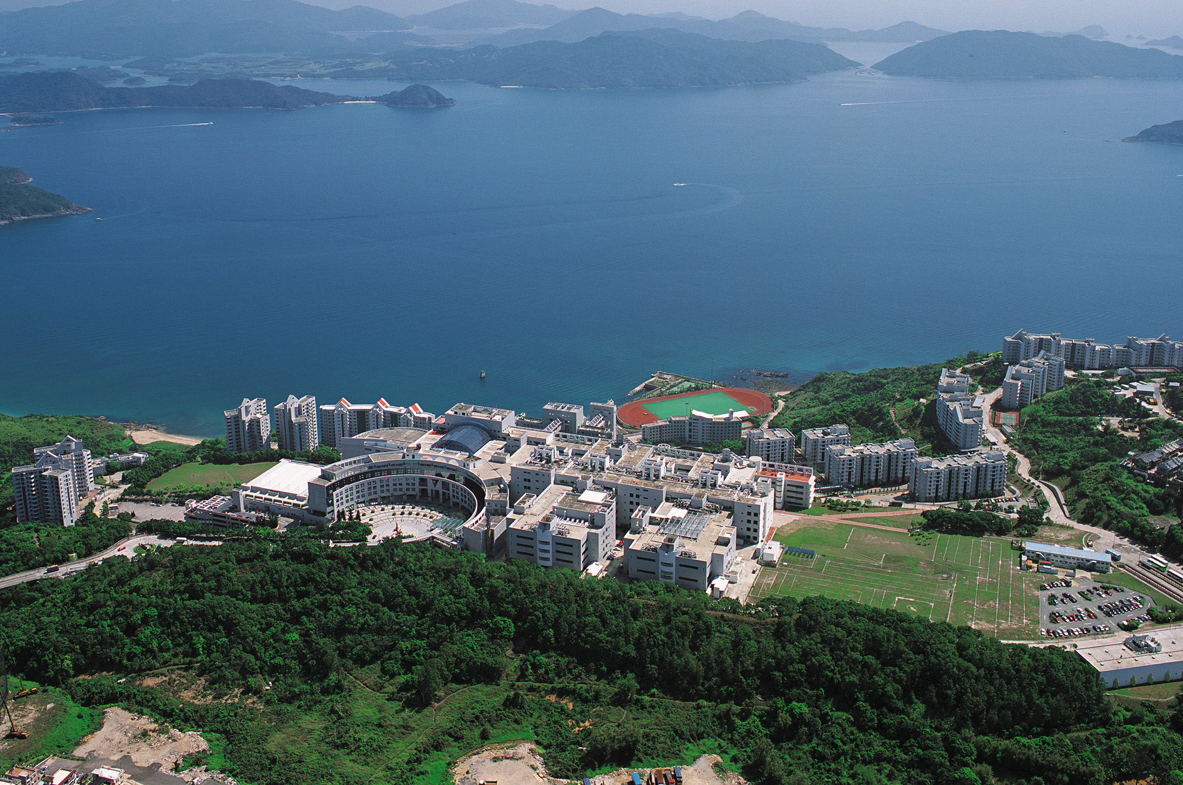
NAMI Office & Laboratories
The Hong Kong University of Science and Technology

Slide 4
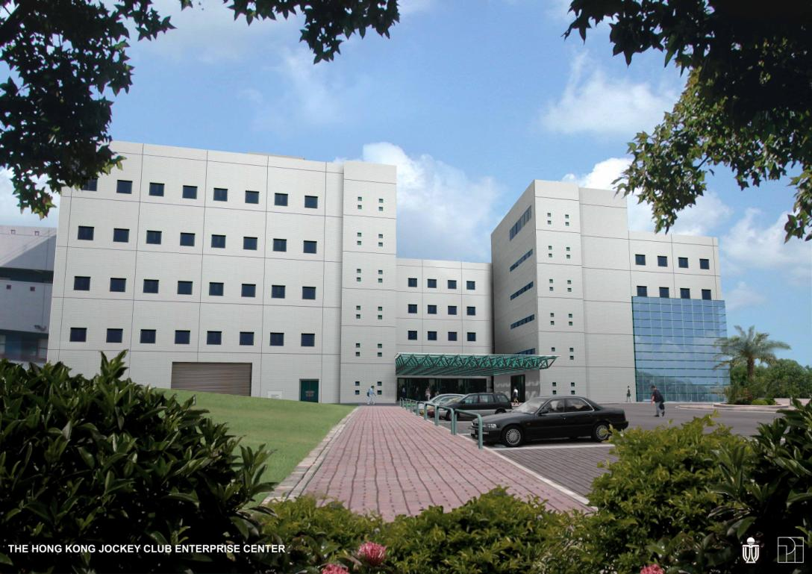

NAMI Office at The Hong Kong University of Science and Technology (HKUST)

Slide 5
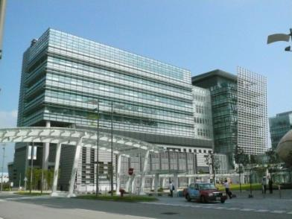
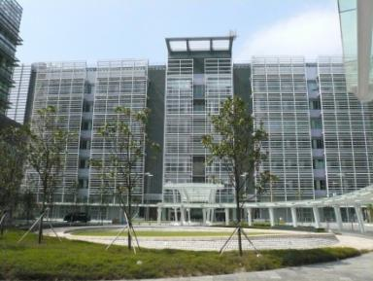
Satellite Offices and Laboratories at HK Science Park
Lakeside 2
Offices 608-609 on 6th floor
Biotech Centre 1
Laboratories 301-305 on 3rd floor

Slide 6
Areas covered by Hong Kong Council for Testing and Certification (HKCTC)
Market sectors covered by NAMI
Environmental Protection
Sustainable Energy
Food
Environmental Technologies
Chinese Medicine
Display and Solid State Lighting
CTC
NAMI
Construction Materials
Construction Materials
Jewellery
Medical and Healthcare Products
ICT
Others

Slide 7
Areas covered by Hong Kong Council for Testing and Certification (HKCTC)
Market sectors covered by NAMI
Environmental Protection
Sustainable Energy
Food
Environmental Technologies
Chinese Medicine
Display and Solid State Lighting
CTC
NAMI
Construction Materials
Construction Materials
Jewellery
Medical and Healthcare Products
ICT
Others

Slide 8

The Road to Accreditation and Certification
Adaptation, Maintenance & Upgrade
Accreditation
Establishment of standard test methods
Product Certification
Generalization & Categorization of Methodology:
Data Base
Results
e.g. Nano-Mark
in Taiwan
Analysis & Characterization
1) Ingredients?
Functional
Performance?

Slide 9
NAMI’s Participation in Testing and Certification
NAMI
Adaptation, Maintenance & Upgrade
NAMI
NAMI
Accreditation
Establishment of standard test methods
Product Certification
NAMI
Generalization & Categorization of Methodology
To develop new (and upgrade existing) testing methods for materials and the corresponding processing technologies
To support the local S&T industry
To enhance the technical competitiveness of the local labor force
To gain worldwide recognition
Analysis & Characterization

Slide 10
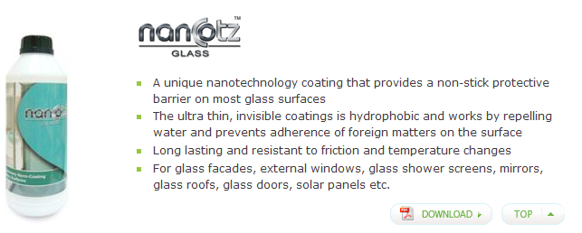
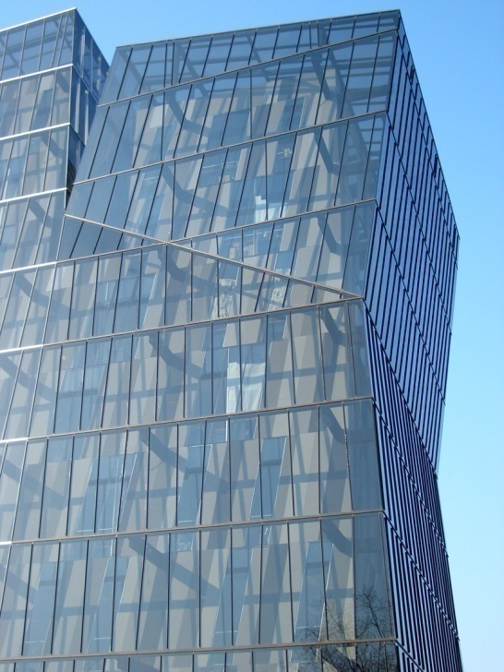
Construction Materials
Claimed to contain nanoparticles (not specified) within the coating making a non-sticking surface
Functional tests: Surface roughness, hydrophobicity , hardness
Material tests: Nature of nanoparticles? Size? Form?

Slide 11
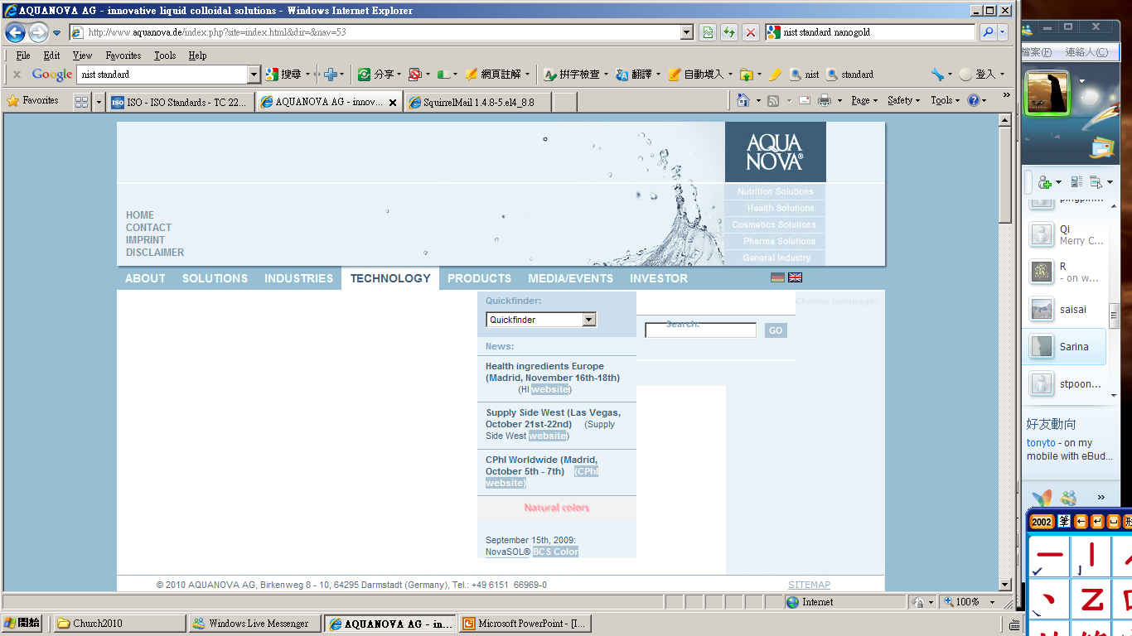
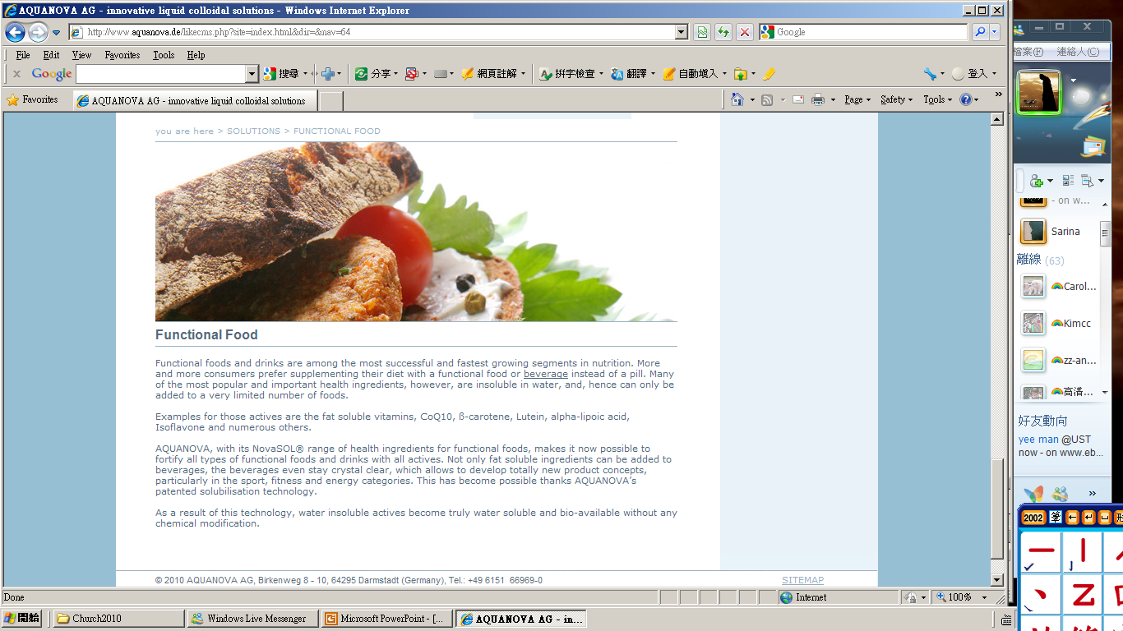
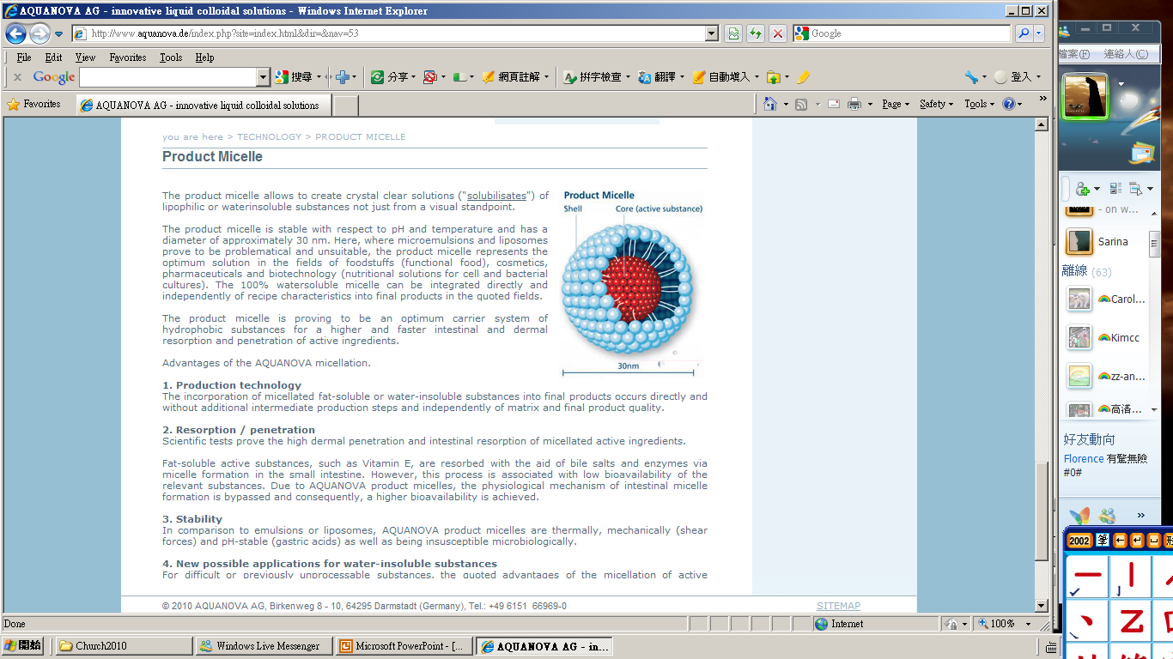
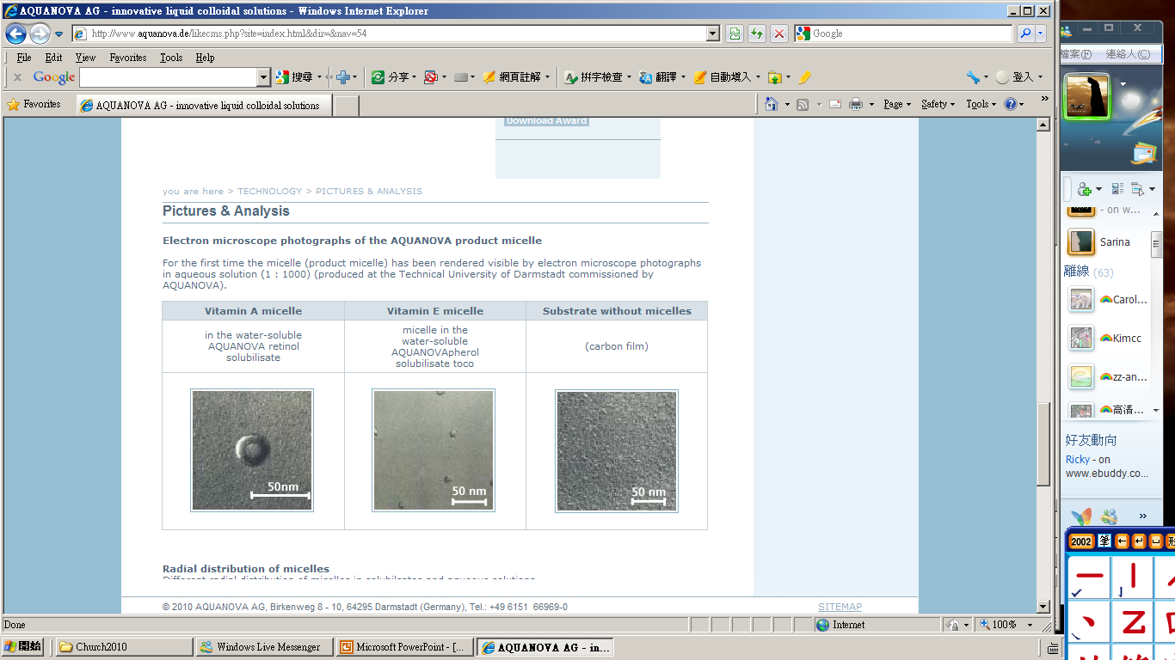
Food
Claimed to have core-shell micelles containing vitamin/protein/nutrient
Functional tests: Activity and efficacy of vitamin/active ingredient?
Material tests: Presence of nanoparticles / chemicals? Size? Core-shell?

Slide 12
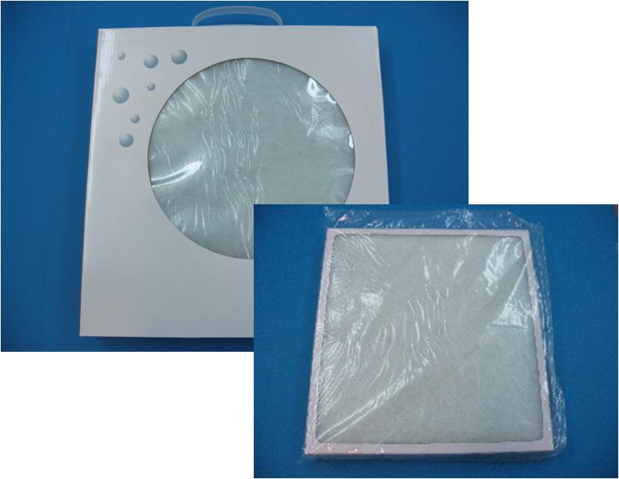
Environmental Protection
A 4-in-1 air filter claimed to have one layer containing “NanoSilver” and one layer having “TiO₂ nanoparticles”
Claimed to be anti-bacterial and decomposes VOCs
Functional tests: Anti-bacterial and photocatalytic properties
Material tests: Presence of Ag and TiO₂? Size? Distribution?

Slide 13

Medical & Healthcare Products
TiO₂ and ZnO nanoparticles are commonly used in sunscreens to block UV light
A product claimed to contain ZnO and TiO₂ nanoparticles and offer a specified SPF
Functional tests: UV absorption
Material tests: Presence of nano ZnO and TiO₂? Size? Size distribution?

Slide 14
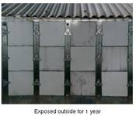


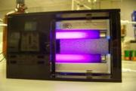



Nano Materials for Air Purification
(
3)
Final products:
CO
2
and Water
(1)
Organic pollutant
adsorbs
to surface
(
2)
Adsorbed pollutant
breaks down
Photocatalyst
Coating
Photocatalytic Self Cleaning &
Anti Bacteria Coating (TiO₂, Nano Ag)
Different Supporting Media
(filter element, pipe, wall etc)
Air Filter, Self Cleaning & Anti Bacteria
Piping, Building & Interior Surfaces

Slide 15
Industrial Wastewater Effluent
Huge water consumption in various industries in China
 | Wastewater Effluent (million ton per yr)
 | 2004 | 2005 | 2006
Textile industry | 1,818 | 1,998 | 2,320
Pulp and paper industry | 3,187 | 3,674 | 3,744
Mining industry | 1,122 | 1,167 | 1,336
Chemical industry | 3,232 | 3,391 | 3,360
Food industry | 1,739 | 2,052 | 1,936
Pharmaceutical industry | 430 | 401 | 430
Other industries | 8,257 | 8,916 | 7,679
Total | 19,784 | 21,598 | 20,804
Source: 中華人民共和國環境保護局 2006年環境統計年報
As a comparison, Hong Kong consumes ~1B ton per year!
Notes:
An estimate of the total annual industrial and domestic water consumption is ~100B ton and ~70B ton per year, respectively, or ~20% and ~16% of the total water consumption in mainland China.

Slide 16
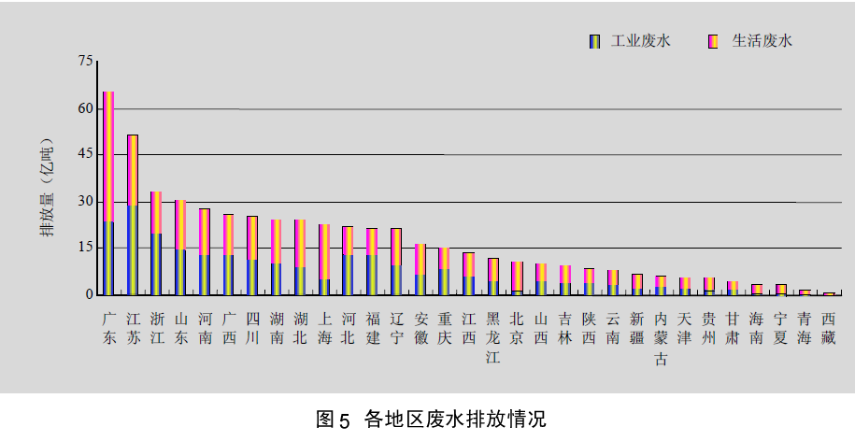
Wastewater Effluent by Province

Slide 17
Industrial Wastewater Pollutants
There is a variety of toxic pollutants and contaminants.
Manufacturing Processes
Pulp and paper
Distillery and brewery
Printed circuit board
Dyeing
Food
Organic
Inorganic
Heavy metals
Microbes
Formaldehyde
Azo dyes
Surfactants
EDTA
PVA
POPs
NaOH
Na₂CO₃
H₂O₂
H₂SO₄
HNO₃
Copper
Palladium
Tin
Nickel
Lead
E. coli
Salmonella
Vibrio parahaemolyticus
Staphylococcus aureus
Bacillus subtilis

Slide 18
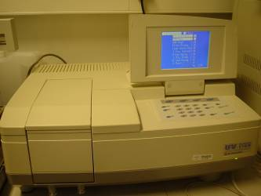
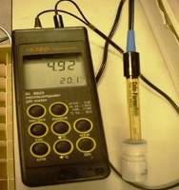

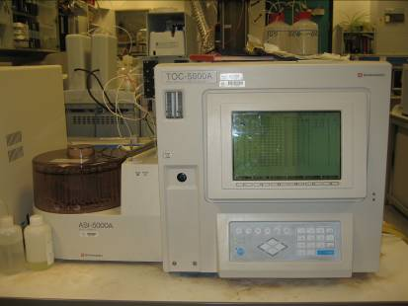

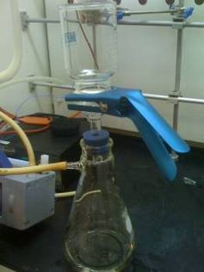
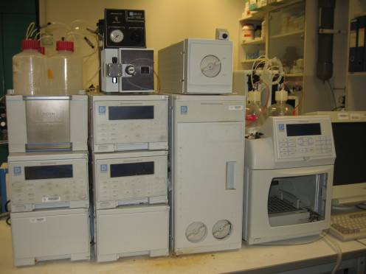
Wastewater Characterization
pH, Conductivity,
Turbidity Measurement
Ultra-violet / Visible Spectroscopy
Chemical & Biochemical
oxygen demand (COD, BOD) Measurement
Total Carbon Content (TOC)
Wastewater Samples
Solids content
(Total dissolved solids TDS, Total suspended solids TSS)
Ion Chromatography (IC)
Inductively Coupled Plasma (ICP)

Slide 19
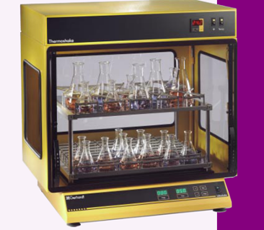
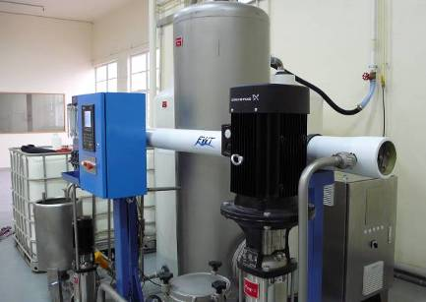
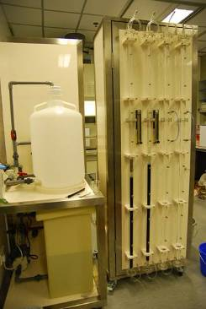
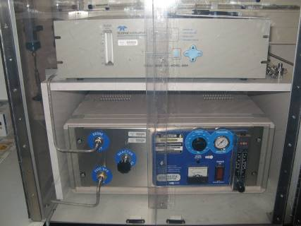
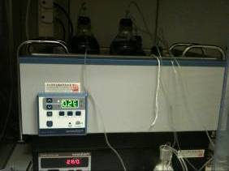
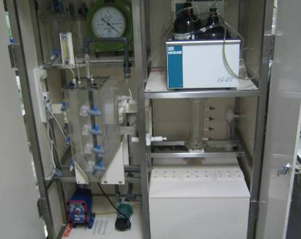
Techniques for Wastewater Treatment Plants
Batch Adsorption Kinetic Tank
Adsorption Isotherm Apparatus
RO Membrane Unit
Fixed Bed Adsorption System
Wastewater Treatment Techniques
Bioreactor
Ozone Treatment
Bioreaction Kinetics
Coagulation (Jar Test)

Slide 20
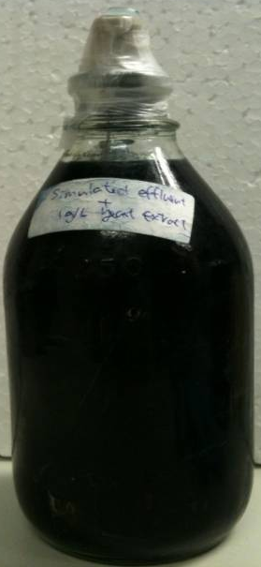
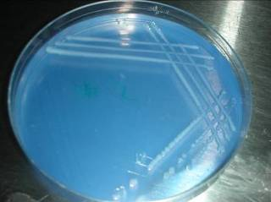
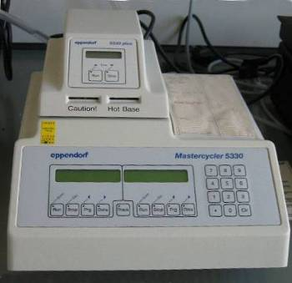
Bioaugmentation
Biotreatment using consortia with isolated bacteria from mixed sludge for wastewater with given pollutants
Bacteria
cultivation
Single population
Bacteria 1
Enzyme 1
Enzyme 2
Substrate
Intermediate
Simple product
Isolation
Intercellular interactions include:
Commensalism, amensalism, mutualism, parasitism
Consortium
Metabolites, etc.
Bacteria 1
Bacteria 2
Substrate 1
Intermediate 1
Simple product 1
Substrate 2
Intermediate 2
Simple product 1
Identification

Slide 21

Contact Information
Prof. Ka M. Ng
Nano and Advanced Materials Limited
Hong Kong University of Science and Technology
Hong Kong
Email: kmng@nami.org.hk
Phone: 2358 8228

