Slide 1
TeleHealth : A Key Technology Initiative
Peter Yum
CTO
Oct. 7, 2010

Slide 2
Agenda
Definition
Vision & Mission
Case Study & Potential Impact
Roadmap

Slide 3
TeleHealth – Definition
Telehealth is the delivery of health-related services and information via advanced telecommunications technologies.
Examples of Clinical Use:
Individuals exchanging health services or education live via videoconference
Transmission of medical data for diagnosis or disease management
Advice on prevention of diseases and promotion of good health by patient monitoring and followup.
Health advice by telephone in emergent cases
Examples for Nonclinical Use:
Distance education including continuing medical education, grand rounds, and patient education
Online information and health data management
Healthcare system integration
Source: Wiki

Slide 4
Vision & Mission – Telehealth KTI
Vision
To facilitate and accelerate the adoption of Telehealth in Hong Kong, PRD, and Greater China Area
Mission:
To perform research and development in the telehealth and telecare, and to develop affordable and manufacturing-ready prototypes in compliance with medical standard and process.
Impact:
Reduce healthcare cost without compromising on care quality
Support caregivers (families and care organization)
Extend reactive care to proactive care
Improve secure access and protect patient’s privacy
Increase efficiency and productivity of healthcare workers

Slide 5
TeleHealth Case Study: Veterans Affairs
Targeted Segment
Home health monitoring to care for patients with high-cost chronic conditions
Telehealth Budget: $72M in 2009 → $163M in 2011
Patients: 35,000
2008 Result:
Hospital Admission: 19%¤
Average Day Spent in Hospital: 25%¤
Use of Video Technology:
“These video technologies make it possible for veteran patients to come to many of VA's community-based outpatient clinics and connect to a specialist physician or other practitioner who may be in a hospital that is dozens, or hundreds or even thousands of miles away”

Slide 6
TeleHealth Case Study: Scotland
Telecare Development Program (2006-2008)
Budget: ₤6.8M
Served Telecare Patient: 7,902
Results: ₤11.1M saving
 | Est. Saving (₤) | % Saving
Increased speed of discharge from hospital | 1,731,944 | 15.5%
Reduced unplanned hospital admission | 3,343,467 | 30.0%
Reduced care home admission | 3,421,621 | 30.7%
Reduced nights of sleepover care purchased | 557,119 | 5.0%
Reduced home check visits | 1,796,039 | 16.1%
Locally identified efficiencies, namely reduced walking nights | 301,000 | 2.7%
Total | 11,151,190 | 100.0%
source: TDP Financial Results, March 2008

Slide 7
TeleHealth Potential Impact for Hong Kong
Community Nurse:
300 community nurses, ~1M visits per year → $216M subsidy per year
E.g. 10% reduction in visit ~ $22M per year
In-Patient (based on 2006 data):
7.8M bed days → ~HK$24.9B subsidy per year
E.g. 10% reduction @ $3190 per day → HK$2.4B
Portable Electronic Patient Folder
24,682 doctors / nurses → staffing cost ~ HK$17B
E.g. 10% improvement in productivity ~HK1.7B saving
Source: HA Health Reform document, UCH, ASTRI estimates

Slide 8
TeleHealth World Market
Global Telehealth Market: $6B in 2008 → $8B in 2012
Remote Patient Monitoring Market in U.S.
CAGR 22.6%
Source: Frost & Sullivan (2008)

Slide 9
The market will be in Asia…
Nation’s Population Over 60 (in millions)
2002 |  | 2025
China | 134.2 | China | 287.5
India | 81.0 | India | 168.5
USA | 46.9 | USA | 86.1
Japan | 31.0 | Japan | 43.5
Russia | 26.2 | Indonesia | 35.0
Indonesia | 17.1 | Brazil | 33.4
Brazil | 14.1 | Russia | 32.7
Source: WHO

Slide 10
TeleHealth Roadmap
ISO 13485 / ISO 11073 Compliance
Proposed Projects
Existing Projects
Telehealth
Hub
Development
Telehealth Portable Tablet (Medical Grade)
LTE, Long battery life, IP65, OS Upgrade
ISO 13485
IP 54
WiFi, Bluetooth™, 3G+
Telehealth Home Hub
Advanced Screen (weight & power)
Security with Privacy Protection
Devices
Development
Compliance-monitor Drug Dispenser
Pulse Oximeter Measurement (ISO 13485)
Pulse Oximeter (non-ISO)
Cuff-less Blood Pressure Measurement
Non-invasive Glucose Monitoring
ATS1 – COPD (non-ISO)
Wearable Device Monitoring
Applications
Community Nurse Portable Patient Record
Portable Electronic Patient Folder
Elderly & Early Discharge Patients
6 months
18 – 24 months
24 – 36 months

Slide 11
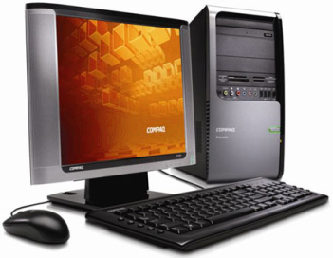
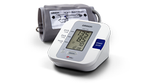
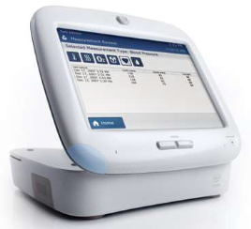
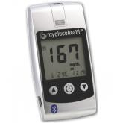
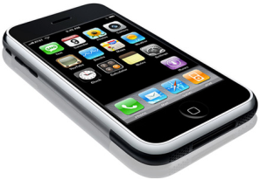
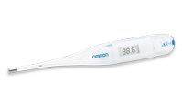
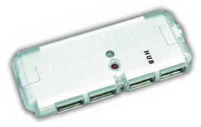
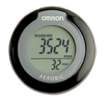
Continua Connectivity Standards
Measurement Devices
11073-10404 = Pulse Oximeter
11073-10406 = Pulse / Heart Rate
11073-10407 = Blood Pressure
11073-10408 = Thermometer
11073-10415 = Weighing Scale
11073-10417 = Glucose
11073-10441 = Cardiovascular Fitness Monitor
11073-10442 = Strength Fitness Equipment
11073-10471 = Independent Living Activity
11073-10472 = Medication Monitor
11073-20601 = Base Framework Protocol
personal computer
personal health system
Phone
Device Aggregator
Personal Health Device Class Specification
Medical Device Profile Specification

